Slide 1
Scoring, Term Weighting, The Vector Space Model
Notes:
WDM 57,58,59,60

Slide 2
Overview
Recap
Why ranked retrieval?
Term frequency
tf-idf weighting
The vector space model

Slide 3
Outline
Recap
Why ranked retrieval?
Term frequency
tf-idf weighting
The vector space model

Slide 4
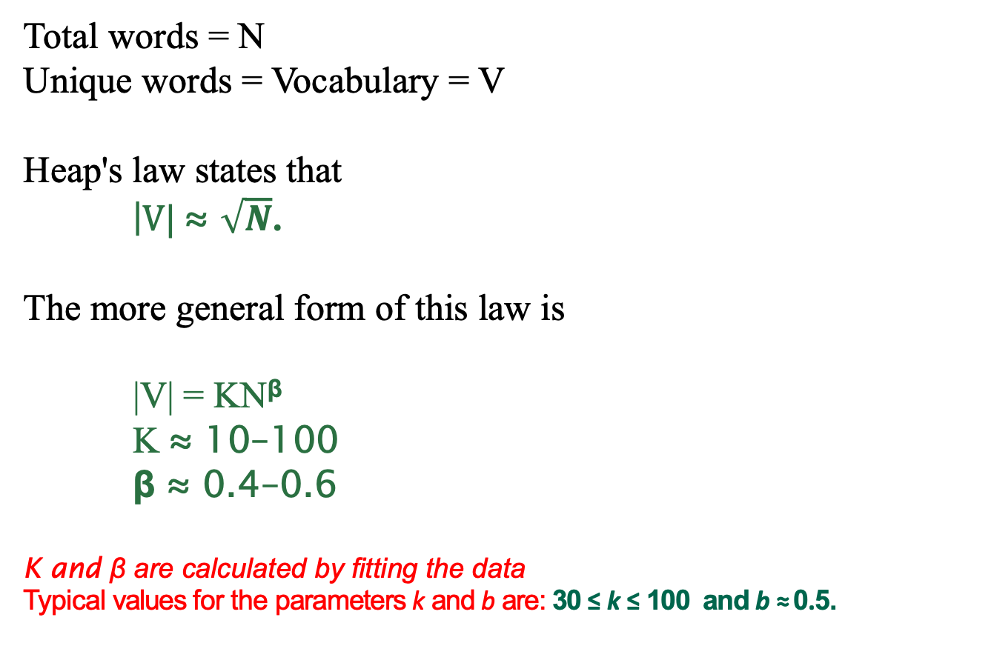
Heaps’ law
Total words = N
Unique words = Vocabulary = V
Heap's law states that
|$V| \text{≈} \sqrt{N}$.
The more general form of this law is
|V| = KN^{β}
K $\text{≈}$ 10–100
β $\text{≈} \text{0.4–0.6}$
K and β are calculated by fitting the data
Typical values for the parameters k and b are: 30 ≤ k ≤ 100 and b ≈ 0.5.
4

Slide 5
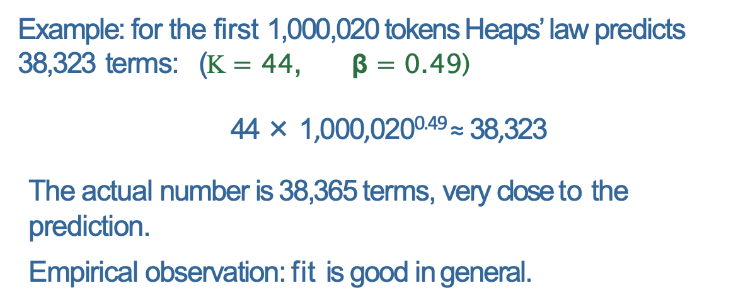
Recap Compression Term statistics Dictionary compression
Empirical fit for Reuters
Postings compression
Example: for the first 1,000,020 tokens Heaps’ law predicts 38,323 terms: (K $=$ 44, β $\text{=} \text{0.4}\text{9)}$
44 × 1,000,020^{0.49} ≈ 38,323
The actual number is 38,365 terms, very close to the prediction.
Empirical observation: fit is good in general.
19 / 59

Slide 6
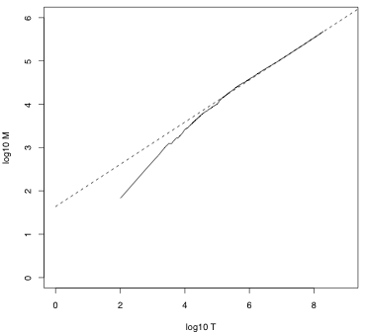
Heaps’ law
Vocabulary size V as a
function of collection size
N (number of tokens) for
Reuters-RCV1. For these
data, the dashed line
log₁₀V =
0.49 ∗ log₁₀ N + 1.64 is the
best least squares fit.
Thus, V = 10^{1.64}T^{0.49}
and k = 10^{1.64} ≈ 44 and
b = 0.49.
6

Slide 7
Zipf’s law
Zipf's law is a law about the frequency distribution of words in a language (or in a collection that is large enough so that it is representative of the language)
V = Vocabulary = unique words in the collection
freq(word) = Frequency of word in the collection
r be the rank
Prob(r) =freq(r)/N
Zipf's law states that
r * Prob(r) = A
A is a constant, empirically determined from the data.
In most cases A = 0.1.
Zipf's law is not an exact law, but a statistical law and therefore does not hold exactly but only on average (for most words)

Slide 8
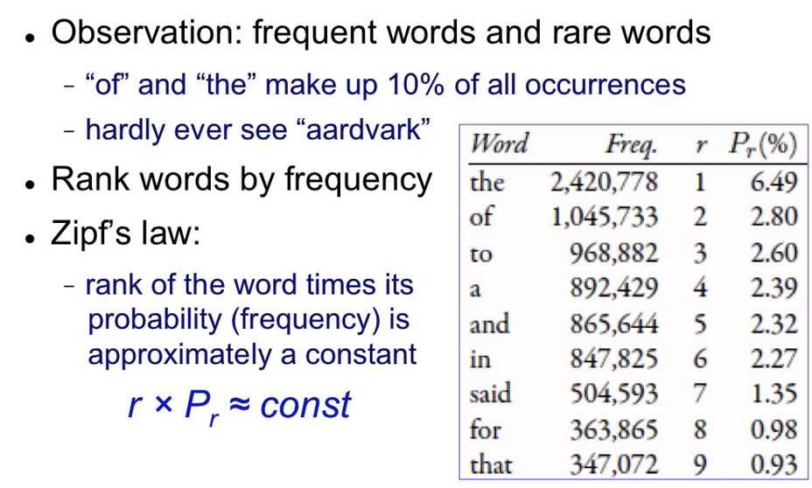
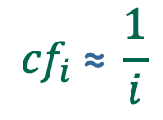
Zipf’s law
r * Prob(r) = A
$${cf}_{i} \text{≈} \frac{1}{i}$$

Slide 9
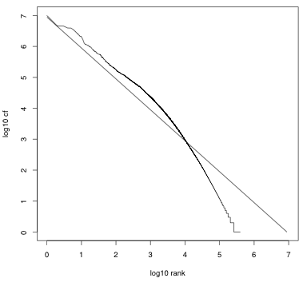

Zipf’s law
The most frequent term
(the) occurs cf₁ times, the
second most frequent term
(of) occurs
times, the third most
frequent term (and) occurs
times etc.
9

Slide 10
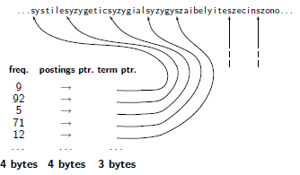
Dictionary as a string
10

Slide 11
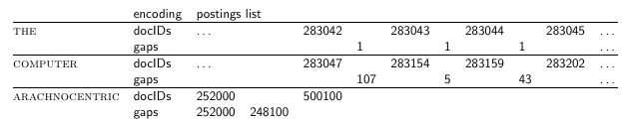
Gap encoding
11

Slide 12
Variable byte (VB) code
Dedicate 1 bit (high bit) to be a continuation bit c.
If the gap G fits within 7 bits, binary-encode it in the 7 available bits and set c = 1.
Else: set c = 0, encode high-order 7 bits and then use one or more additional bytes to encode the lower order bits using the same algorithm.
12

Slide 13
Gamma codes for gap encoding
Represent a gap G as a pair of length and offset.
Offset is the gap in binary, with the leading bit chopped off.
Length is the length of offset.
Encode length in unary code
The Gamma code is the concatenation of length and offset.
13

Slide 14
Compression of Reuters
data structure | size in MB
dictionary, fixed-width dictionary, term pointers into string ∼, with blocking, k = 4 ∼, with blocking & front coding collection (text, xml markup etc) collection (text) T/D incidence matrix postings, uncompressed (32-bit words) postings, uncompressed (20 bits) postings, variable byte encoded postings, γ encoded | 11.2 7.6 7.1 5.9 3600.0 960.0 40,000.0 400.0 250.0 116.0 101.0
14

Slide 15
Take-away today
Ranking search results: why it is important (as opposed to just presenting a set of unordered Boolean results)
Term frequency: This is a key ingredient for ranking.
Tf-idf ranking: best known traditional ranking scheme
Vector space model: One of the most important formal models for information retrieval (along with Boolean and probabilistic models)
15

Slide 17
Outline
Recap
Why ranked retrieval?
Term frequency
tf-idf weighting
The vector space model

Slide 18
Ranked retrieval
Thus far, our queries have all been Boolean.
Documents either match or don’t.
Good for expert users with precise understanding of their needs and of the collection.
Also good for applications: Applications can easily consum 1000s of results.
Not good for the majority of users
Most users are not capable of writing Boolean queries . . .
. . . or they are, but they think it’s too much work.
Most users don’t want to wade through 1000s of results.
This is particularly true of web search.
18

Slide 19
Problem with Boolean search: Feast or famine
Boolean queries often result in either too few (=0) or too many (1000s) results.
Query 1 (boolean conjunction): [standard user dlink 650]
→ 200,000 hits – feast
Query 2 (boolean conjunction): [standard user dlink 650 no card found]
→ 0 hits – famine
In Boolean retrieval, it takes a lot of skill to come up with a query that produces a manageable number of hits.
19

Slide 20
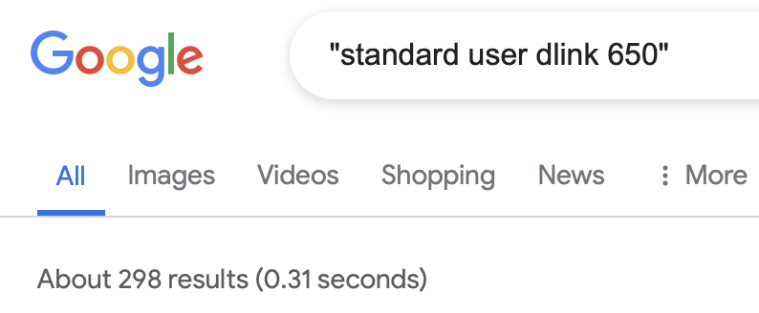
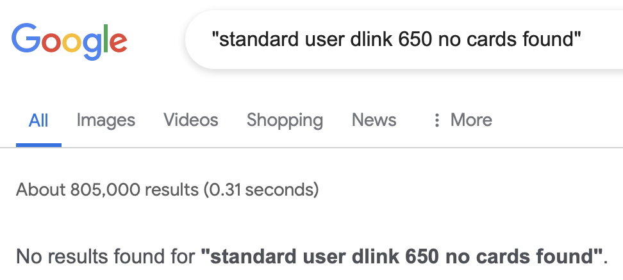
Problem with Boolean search: Feast or famine
20

Slide 21
Feast or famine: No problem in ranked retrieval
With ranking, large result sets are not an issue.
Just show the top 10 results
Doesn’t overwhelm the user
Premise: the ranking algorithm works: More relevant results are ranked higher than less relevant results.
21
Notes:
FAM-in

Slide 22
Scoring as the basis of ranked retrieval
We wish to rank documents that are more relevant higher than documents that are less relevant.
How can we accomplish such a ranking of the documents in the collection with respect to a query?
Assign a score to each query-document pair, say in [0, 1].
This score measures how well document and query “match”.
22

Slide 23
Query-document matching scores
How do we compute the score of a query-document pair?
Let’s start with a one-term query.
If the query term does not occur in the document: score should be 0.
The more frequent the query term in the document, the higher the score
We will look at a number of alternatives for doing this.
23

Slide 24

Take 1: Jaccard coefficient
A commonly used measure of overlap of two sets
Let A and B be two sets
Jaccard coefficient:
JACCARD (A, A) = 1
JACCARD (A, B) = 0 if A ∩ B = 0
A and B don’t have to be the same size.
Always assigns a number between 0 and 1.
24

Slide 25


Jaccard coefficient: Example
What is the query-document match score that the Jaccard coefficient computes for:
Query: “ides of March”
Document “Caesar died in March”
JACCARD(q, d) =
$$\frac{1}{6}$$
Document “ready to March”
JACCARD(q, d) =
$$\frac{1}{5}$$
25

Slide 26

What’s wrong with Jaccard?
It doesn’t consider term frequency (how many occurrences a term has).
Rare terms are more informative than frequent terms. Jaccard does not consider this information.
We need a more sophisticated way of normalizing for the length of a document.
Later in this lecture, we’ll use (cosine) . . .
. . . instead of |A ∩ B|/|A ∪ B| (Jaccard) for length normalization.
26

Slide 27
Outline
Recap
Why ranked retrieval?
Term frequency
tf-idf weighting
The vector space model

Slide 28
Binary incidence matrix
 | Anthony and Cleopatra | Julius Caesar | The Tempest | Hamlet | Othello | Macbeth . . .
ANTHONY BRUTUS CAESAR CALPURNIA CLEOPATRA MERCY WORSER . . . | 1 1 1 0 1 1 1 | 1 1 1 1 0 0 0 | 0 0 0 0 0 1 1 | 0 1 1 0 0 1 1 | 0 0 1 0 0 1 1 | 1 0 1 0 0 1 0
Each document is represented as a binary vector ∈ {0, 1}^{|V|.}
28

Slide 29
Binary incidence matrix
 | Anthony and Cleopatra | Julius Caesar | The Tempest | Hamlet | Othello | Macbeth . . .
ANTHONY BRUTUS CAESAR CALPURNIA CLEOPATRA MERCY WORSER . . . | 157 4 232 0 57 2 2 | 73 157 227 10 0 0 0 | 0 0 0 0 0 3 1 | 0 2 2 0 0 8 1 | 0 0 1 0 0 5 1 | 1 0 0 0 0 8 5
Each document is now represented as a count vector ∈ N^{|V|.}
29

Slide 30
Bag of words model
We do not consider the order of words in a document.
John is quicker than Mary and Mary is quicker than John are represented the same way.
This is called a bag of words model.
In a sense, this is a step back: The positional index was able to distinguish these two documents.
We will look at “recovering” positional information later in this course.
For now: bag of words model
30

Slide 31
Term frequency tf
The term frequency tf_{t,d} of term t in document d is defined as the number of times that t occurs in d.
We want to use tf when computing query-document match scores.
But how?
Raw term frequency is not what we want because:
A document with tf = 10 occurrences of the term is more relevant than a document with tf = 1 occurrence of the term.
But not 10 times more relevant.
Relevance does not increase proportionally with term frequency.
31

Slide 32

Instead of raw frequency: Log frequency weighting
The log frequency weight of term t in d is defined as follows
tf_{t,d} → w_{t,d} : 0 → 0, 1 → 1, 2 → 1.3, 10 → 2, 1000 → 4, etc.
Score for a document-query pair: sum over terms t in both q and d: tf-matching-score(q, d) = _{t∈q∩d} (1 + log tf_{t,d} )
The score is 0 if none of the query terms is present in the document.
32

Slide 33
Exercise
Compute the Jaccard matching score and the tf matching score for the following query-document pairs.
q: [information on cars] d: “all you have ever wanted to know about cars”
q: [information on cars] d: “information on trucks, information on planes, information on trains”
q: [red cars and red trucks] d: “cops stop red cars more often”
33
Notes:
Jaccard 1/11 =0.091, 2 / 6=1/3 = 0.33, 2/8 = 1/4 = 0.25
tf 1, 1+log(3)*2= 2.9 2

Slide 34
Frequency in document vs. frequency in collection
In addition, to term frequency (the frequency of the term in the document) . . .
. . .we also want to use the frequency of the term in the collection for weighting and ranking.
34

Slide 35
 | Frequency |  |  | 1+log10(tf)
 | d1 | d2 | d3 | d1 | d2 | d3
about | 1 | 0 | 0 | 1 | 0 | 0
all | 1 | 0 | 0 | 1 | 0 | 0
cars | 1 | 0 | 1 | 1 | 0 | 1
cops | 0 | 0 | 1 | 0 | 0 | 1
ever | 1 | 0 | 0 | 1 | 0 | 0
have | 1 | 0 | 0 | 1 | 0 | 0
information | 0 | 3 | 0 | 0 | 1.5 | 0
know | 1 | 0 | 0 | 1 | 0 | 0
more | 0 | 0 | 1 | 0 | 0 | 1
often | 0 | 0 | 1 | 0 | 0 | 1
on | 0 | 3 | 0 | 0 | 1.5 | 0
planes | 0 | 1 | 0 | 0 | 1 | 0
red | 0 | 0 | 1 | 0 | 0 | 1
stop | 0 | 0 | 1 | 0 | 0 | 1
to | 1 | 0 | 0 | 1 | 0 | 0
trains | 0 | 1 | 0 | 0 | 1 | 0
trucks | 0 | 1 | 0 | 0 | 1 | 0
wanted | 1 | 0 | 0 | 1 | 0 | 0
you | 1 | 0 | 0 | 1 | 0 | 0

Slide 36
Outline
Recap
Why ranked retrieval?
Term frequency
tf-idf weighting
The vector space model

Slide 37
Desired weight for rare terms
Rare terms are more informative than frequent terms.
Consider a term in the query that is rare in the collection (e.g., ARACHNOCENTRIC).
A document containing this term is very likely to be relevant.
→ We want high weights for rare terms like ARACHNOCENTRIC.
37

Slide 38
Desired weight for frequent terms
Frequent terms are less informative than rare terms.
Consider a term in the query that is frequent in the collection (e.g., GOOD, INCREASE, LINE).
A document containing this term is more likely to be relevant than a document that doesn’t . . .
. . . but words like GOOD, INCREASE and LINE are not sure indicators of relevance.
→ For frequent terms like GOOD, INCREASE and LINE, we want positive weights . . .
. . . but lower weights than for rare terms.
38

Slide 39
Document frequency
We want high weights for rare terms like ARACHNOCENTRIC.
We want low (positive) weights for frequent words like GOOD, INCREASE and LINE.
We will use document frequency to factor this into computing the matching score.
The document frequency is the number of documents in the collection that the term occurs in.
39

Slide 40

idf weight
df_{t} is the document frequency, the number of documents that t occurs in.
df_{t} is an inverse measure of the informativeness of term t.
We define the idf weight of term t as follows:
(N is the number of documents in the collection.)
idf_{t} is a measure of the informativeness of the term.
[log N/df_{t} ] instead of [N/df_{t} ] to “dampen” the effect of idf
Note that we use the log transformation for both term frequency and document frequency.
40

Slide 41

Examples for idf
Compute idf_{t} using the formula:
term | df_{t} | idf_{t}
calpurnia animal sunday fly under the | 1 100 1000 10,000 100,000 1,000,000
6 4 3 2 1 0
41

Slide 42
 | Frequency |  |  | tf |  |  | idf
 | d1 | d2 | d3 | d1 | d2 | d3
about | 1 | 0 | 0 | 1 | 0 | 0 | 0.48
all | 1 | 0 | 0 | 1 | 0 | 0 | 0.48
cars | 1 | 0 | 1 | 1 | 0 | 1 | 0.18
cops | 0 | 0 | 1 | 0 | 0 | 1 | 0.48
ever | 1 | 0 | 0 | 1 | 0 | 0 | 0.48
have | 1 | 0 | 0 | 1 | 0 | 0 | 0.48
info.. | 0 | 3 | 0 | 0 | 1.5 | 0 | 0.48
know | 1 | 0 | 0 | 1 | 0 | 0 | 0.48
more | 0 | 0 | 1 | 0 | 0 | 1 | 0.48
often | 0 | 0 | 1 | 0 | 0 | 1 | 0.48
on | 0 | 3 | 0 | 0 | 1.5 | 0 | 0.48
planes | 0 | 1 | 0 | 0 | 1 | 0 | 0.48
red | 0 | 0 | 1 | 0 | 0 | 1 | 0.48
stop | 0 | 0 | 1 | 0 | 0 | 1 | 0.48
to | 1 | 0 | 0 | 1 | 0 | 0 | 0.48
trains | 0 | 1 | 0 | 0 | 1 | 0 | 0.48
trucks | 0 | 1 | 0 | 0 | 1 | 0 | 0.48
wanted | 1 | 0 | 0 | 1 | 0 | 0 | 0.48
you | 1 | 0 | 0 | 1 | 0 | 0 | 0.48

Slide 43
Effect of idf on ranking
idf affects the ranking of documents for queries with at least two terms.
For example, in the query “arachnocentric line”, idf weighting increases the relative weight of ARACHNOCENTRIC and decreases the relative weight of LINE.
idf has little effect on ranking for one-term queries.
43

Slide 44
Collection frequency vs. Document frequency
word | collection frequency | document frequency
INSURANCE TRY | 10440 10422 | 3997 8760
Collection frequency of t: number of tokens of t in the collection
Document frequency of t: number of documents t occurs in
Why these numbers?
Which word is a better search term (and should get a higher weight)?
This example suggests that df (and idf) is better for weighting than cf (and “icf”).
44

Slide 45

tf-idf weighting
The tf-idf weight of a term is the product of its tf weight and its idf weight.
tf-weight
idf-weight
Best known weighting scheme in information retrieval
Note: the “-” in tf-idf is a hyphen, not a minus sign!
Alternative names: tf.idf, tf x idf
45

Slide 46

Summary: tf-idf
Assign a tf-idf weight for each term t in each document d:
The tf-idf weight . . .
. . . increases with the number of occurrences within a document. (term frequency)
. . . increases with the rarity of the term in the collection. (inverse document frequency)
46

Slide 47
Exercise: Term, collection and document frequency
Quantity | Symbol | Definition
term frequency document frequency collection frequency | tf_{t,d} df_{t} cf_{t} | number of occurrences of t in d number of documents in the collection that t occurs in total number of occurrences of t in the collection
Relationship between df and cf?
Relationship between tf and cf?
Relationship between tf and df?
47

Slide 48
Exercise
Compute the Jaccard matching score and the tf matching score for the following query-document pairs.
q: [information on cars] d: “all you have ever wanted to know about cars”
q: [information on cars] d: “information on trucks, information on planes, information on trains”
q: [red cars and red trucks] d: “cops stop red cars more often”
48
Notes:
Jaccard 1/11 =0.091, 2 / 6=1/3 = 0.33, 2/8 = 1/4 = 0.25
tf 1, 1+log(3)*2= 2.9 2

Slide 49
Outline
Recap
Why ranked retrieval?
Term frequency
tf-idf weighting
The vector space model

Slide 50
Binary incidence matrix
 | Anthony and Cleopatra | Julius Caesar | The Tempest | Hamlet | Othello | Macbeth . . .
ANTHONY BRUTUS CAESAR CALPURNIA CLEOPATRA MERCY WORSER . . . | 1 1 1 0 1 1 1 | 1 1 1 1 0 0 0 | 0 0 0 0 0 1 1 | 0 1 1 0 0 1 1 | 0 0 1 0 0 1 1 | 1 0 1 0 0 1 0
Each document is represented as a binary vector ∈ {0, 1}^{|V|.}
50

Slide 51
Count matrix
 | Anthony and Cleopatra | Julius Caesar | The Tempest | Hamlet | Othello | Macbeth . . .
ANTHONY BRUTUS CAESAR CALPURNIA CLEOPATRA MERCY WORSER . . . | 157 4 232 0 57 2 2 | 73 157 227 10 0 0 0 | 0 0 0 0 0 3 1 | 0 2 2 0 0 8 1 | 0 0 1 0 0 5 1 | 1 0 0 0 0 8 5
Each document is now represented as a count vector ∈ N^{|V|.}
51

Slide 52
Binary → count → weight matrix
 | Anthony and Cleopatra | Julius Caesar | The Tempest | Hamlet | Othello | Macbeth . . .
ANTHONY BRUTUS CAESAR CALPURNIA CLEOPATRA MERCY WORSER . . . | 5.25 1.21 8.59 0.0 2.85 1.51 1.37 | 3.18 6.10 2.54 1.54 0.0 0.0 0.0 | 0.0 0.0 0.0 0.0 0.0 1.90 0.11 | 0.0 1.0 1.51 0.0 0.0 0.12 4.15 | 0.0 0.0 0.25 0.0 0.0 5.25 0.25 | 0.35 0.0 0.0 0.0 0.0 0.88 1.95
Each document is now represented as a real-valued vector of tf idf weights ∈ R^{|V|.}
52

Slide 53
Documents as vectors
Each document is now represented as a real-valued vector of tf-idf weights ∈ R^{|V|.}
So we have a |V|-dimensional real-valued vector space.
Terms are axes of the space.
Documents are points or vectors in this space.
Very high-dimensional: tens of millions of dimensions when you apply this to web search engines
Each vector is very sparse - most entries are zero.
53

Slide 54
Queries as vectors
Key idea 1: do the same for queries: represent them as vectors in the high-dimensional space
Key idea 2: Rank documents according to their proximity to the query
proximity = similarity
proximity ≈ negative distance
Recall: We’re doing this because we want to get away from the you’re-either-in-or-out, feast-or-famine Boolean model.
Instead: rank relevant documents higher than irrelevant documents
54

Slide 55
How do we formalize vector space similarity?
First cut: (negative) distance between two points
( = distance between the end points of the two vectors)
Euclidean distance?
Euclidean distance is a bad idea . . .
. . . because Euclidean distance is large for vectors of different lengths.
55

Slide 56
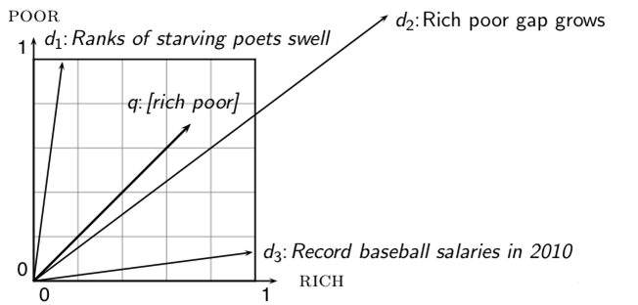
Why distance is a bad idea
The Euclidean distance of and is large although the distribution of terms in the query q
and the distribution of terms in the document d₂ are very similar.
Questions about basic vector space setup?
56

Slide 57
Use angle instead of distance
Rank documents according to angle with query
Thought experiment: take a document d and append it to itself. Call this document d′. d′ is twice as long as d.
“Semantically” d and d′ have the same content.
The angle between the two documents is 0, corresponding to maximal similarity . . .
. . . even though the Euclidean distance between the two documents can be quite large.
57

Slide 58
From angles to cosines
The following two notions are equivalent.
Rank documents according to the angle between query and document in decreasing order
Rank documents according to cosine(query,document) in increasing order
Cosine is a monotonically decreasing function of the angle for the interval [0◦, 180◦]
58

Slide 59
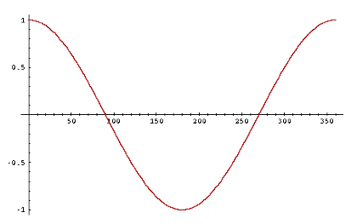
Cosine
59

Slide 60


Length normalization
How do we compute the cosine?
A vector can be (length-) normalized by dividing each of its components by its length – here we use the L₂ norm:
This maps vectors onto the unit sphere . . .
. . . since after normalization:
As a result, longer documents and shorter documents have weights of the same order of magnitude.
Effect on the two documents d and d′ (d appended to itself) from earlier slide: they have identical vectors after length-normalization.
60

Slide 61

Cosine similarity between query and document
q_{i} is the tf-idf weight of term i in the query.
d_{i} is the tf-idf weight of term i in the document.
| | and | | are the lengths of and
This is the cosine similarity of and . . . . . . or, equivalently, the cosine of the angle between and
61

Slide 62

Cosine for normalized vectors
For normalized vectors, the cosine is equivalent to the dot product or scalar product.
(if and are length-normalized).
62

Slide 63
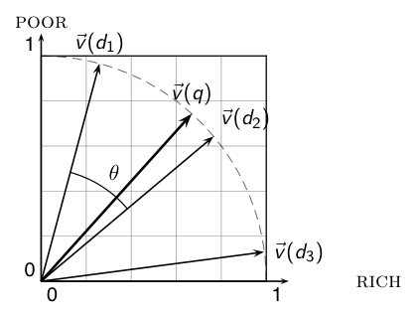
Cosine similarity illustrated
63

Slide 64
Cosine: Example
term frequencies (counts)
How similar are
these novels? SaS:
Sense and
Sensibility PaP:
Pride and
Prejudice WH:
Wuthering
Heights
term | SaS | PaP | WH
AFFECTION JEALOUS GOSSIP WUTHERING | 115 10 2 0 | 58 7 0 0 | 20 11 6 38
64

Slide 65
Cosine: Example
term frequencies (counts) log frequency weighting
(To simplify this example, we don't do idf weighting.)
term | SaS | PaP | WH
AFFECTION JEALOUS GOSSIP WUTHERING | 115 10 2 0 | 58 7 0 0 | 20 11 6 38
term | SaS | PaP | WH
AFFECTION JEALOUS GOSSIP WUTHERING | 3.06 2.0 1.30 0 | 2.76 1.85 0 0 | 2.30 2.04 1.78 2.58
65

Slide 66
Cosine: Example
log frequency weighting log frequency weighting &
cosine normalization
term | SaS | PaP | WH
AFFECTION JEALOUS GOSSIP WUTHERING | 3.06 2.0 1.30 0 | 2.76 1.85 0 0 | 2.30 2.04 1.78 2.58
term | SaS | PaP | WH
AFFECTION JEALOUS GOSSIP WUTHERING | 0.789 0.515 0.335 0.0 | 0.832 0.555 0.0 0.0 | 0.524 0.465 0.405 0.588
cos(SaS,PaP) ≈ 0.789 ∗ 0.832 + 0.515 ∗ 0.555 + 0.335 ∗ 0.0 + 0.0 ∗ 0.0 ≈ 0.94.
cos(SaS,WH) ≈ 0.79
cos(PaP,WH) ≈ 0.69
Why do we have cos(SaS,PaP) > cos(SAS,WH)?
66

Slide 67
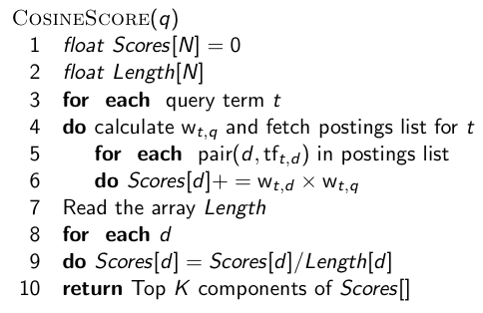
Computing the cosine score
67

Slide 68
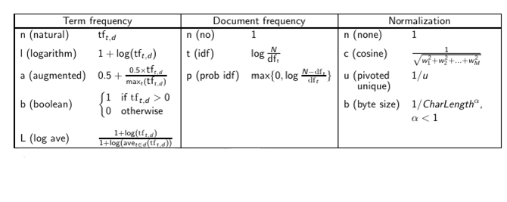
Components of tf-idf weighting
68

Slide 69
tf-idf example
We often use different weightings for queries and documents.
Notation: ddd.qqq
Example: lnc.ltn
document: logarithmic tf, no df weighting, cosine normalization
query: logarithmic tf, idf, no normalization
Isn’t it bad to not idf-weight the document?
Example query: “best car insurance”
Example document: “car insurance auto insurance”
69

Slide 70
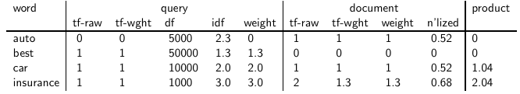
tf-idf example: Inc.Itn
Query: “best car insurance”. Document: “car insurance auto insurance”.
Key to columns: tf-raw: raw (unweighted) term frequency, tf-wght: logarithmically weighted term frequency, df: document frequency, idf: inverse document frequency, weight: the final weight of the term in the query or document, n’lized: document weights after cosine normalization, product: the product of final query weight and final document weight
1/1.92 ≈ 0.52
1.3/1.92 ≈ 0.68 Final similarity score between query and
document: _{i} w_{qi} · w_{di} = 0 + 0 + 1.04 + 2.04 = 3.08 Questions?
70

Slide 71
Summary: Ranked retrieval in the vector space model
Represent the query as a weighted tf-idf vector
Represent each document as a weighted tf-idf vector
Compute the cosine similarity between the query vector and each document vector
Rank documents with respect to the query
Return the top K (e.g., K = 10) to the user
71

Slide 72
Take-away today
Ranking search results: why it is important (as opposed to just presenting a set of unordered Boolean results)
Term frequency: This is a key ingredient for ranking.
Tf-idf ranking: best known traditional ranking scheme
Vector space model: One of the most important formal models for information retrieval (along with Boolean and probabilistic models)
72

Slide 73
Resources
Chapters 6 and 7 of IIR
Resources at http://ifnlp.org/ir
Vector space for dummies
Exploring the similarity space (Moffat and Zobel, 2005)
Okapi BM25 (a state-of-the-art weighting method, 11.4.3 of IIR)
73

